Slide 1
Basics Building Blocks Of Python – Control Structures
Source: . Charles Dierbach "Introduction to Computer Science using Python: A Computational Problem-Solving Focus"

Slide 2
Control Structure
Control flow is the order that instructions are executed in a program
sequential control, selection control, and iterative control.

Slide 3
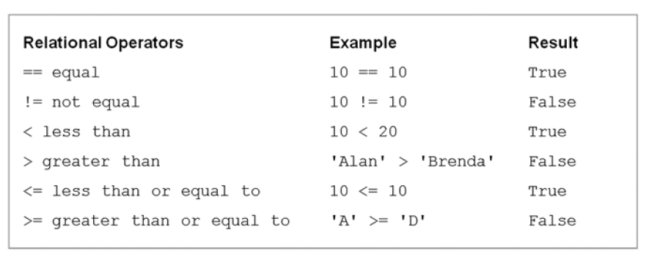
Boolean Expressions
Boolean data type - True and False (1 and 0)
Boolean expression are used to denote the conditions for selection and iterative control statements
Relational Operators

Slide 4
num = 10 variable num is assigned the value 10
num == 10 variable num is compared to the value 10
Membership Operators

Slide 5
Boolean (logical) Operators
Meaning less in most of programming language, but Python support

Slide 6
Operator Precedence and Boolean Expressions

Slide 7

Short-Circuit (Lazy) Evaluation
In short-circuit (lazy) evaluation, the second operand of Boolean operators and and or is not evaluated if the value of the Boolean expression can be determined from the first operand alone.

Slide 8
Logically Equivalent Boolean Expressions

Slide 9
Selection Control
If Statement

Slide 10
Indentation in Python

Slide 13
Nested if Statements

Slide 14
elif Header in Python

Slide 15
Iterative Control
An iterative control statement is a control statement that allows for the repeated execution of a set of statements.
While Statement

Slide 16
n=3

Slide 18
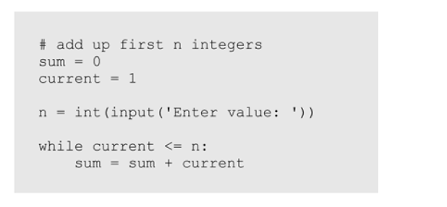
Infinite loops

Slide 19
Definite vs. Indefinite Loops
A definite loop is a program loop in which the number of times the loop will iterate can be determined before the loop is executed.
An indefinite loop is a program loop in which the number of times that the loop will iterate cannot be determined before the loop is executed.

Slide 20
to find Even number between 1 to 50
to find if a number is prime or not
to find Factorial of number n ( n!=1x2x3x…n)
to find all the divisor of a number
to reverse a number
for generation of prime numbers

